Slide 1

Advanced Artificial Intelligence
Week # 10
Dr. Qurat Ul Ain
Assistant Professor
Dept. of AI & DS
FAST NUCES, Islamabad
Email: quratul.ain@isb.nu.edu.pk

Slide 2
Local Search Algorithm in Artificial Intelligence
Local search algorithms are important in artificial intelligence as they can quickly find good answers, especially when finding the perfect solution would take too long or too much effort. They are useful for big or complex problems where checking every possible option isn't practical.
It focus only on the current solution and the ones directly related to it rather than looking everywhere.
Ideal for real-world tasks like puzzles, timetables or route finding.

Slide 3
Working of Local Search Algorithms
Step 1: Pick a starting point: Start with a possible solution which is often random but sometimes based on rule.
Step 2: Find the neighbors:
Neighbors are similar solutions we can get by making small, simple changes to the current one.
For example, in a puzzle, swapping two pieces creates a neighbor.
Step 3: Compare: Look around at all neighbors to see if any are better.
Step 4: Move: If a better neighbor exists, move to it, making it our new “current” solution.
Step 5: Repeat: Keep searching from the new point, following the same steps.
Step 6: Stop: When none of the neighbors are better or after enough tries.

Slide 4
Types of Local Search Algorithms
1. Hill-Climbing Search Algorithm
Hill-Climbing search algorithm is a straightforward local search algorithm that iteratively moves towards better solutions. It is often used for optimization problems where the goal is to find the peak of a landscape, represented by an objective function.
Process:
Start: Begin with an initial solution.
Evaluate: Assess the neighboring solutions.
Move: Transition to the neighbor with the highest objective function value if it improves the current solution.
Repeat: Continue this process until no better neighboring solution exists.
Pros:
Easy to implement.
Works well in small or smooth search spaces.
Cons:
May get stuck in local optima.
Limited exploration of the search space.

Slide 5
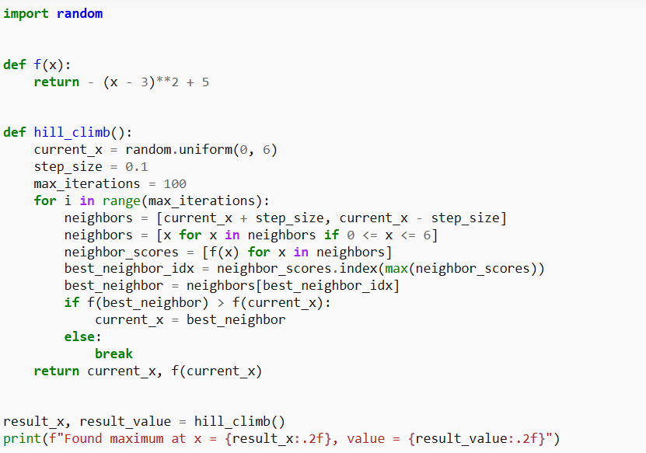

Hill-Climbing Search Algorithm

Slide 6
2. Simulated Annealing
Simulated Annealing is inspired by the annealing process in metallurgy, where materials are heated and then gradually cooled to remove defects. It allows for occasional moves to worse solutions to escape local optima, with the probability of such moves decreasing over time.
Process:
Start: Begin with an initial solution and an initial temperature.
Move: Transition to a neighboring solution with a certain probability.
Cooling Schedule: Gradually reduce the temperature according to a predefined schedule.
Probability Function: Accept worse solutions with a probability that decreases as the temperature decreases.
Pros:
Can escape local optima due to probabilistic acceptance of worse solutions.
Flexible in exploring the solution space.
Cons:
Requires careful tuning of parameters like temperature and cooling schedule.
Computationally expensive due to repeated evaluations.

Slide 7
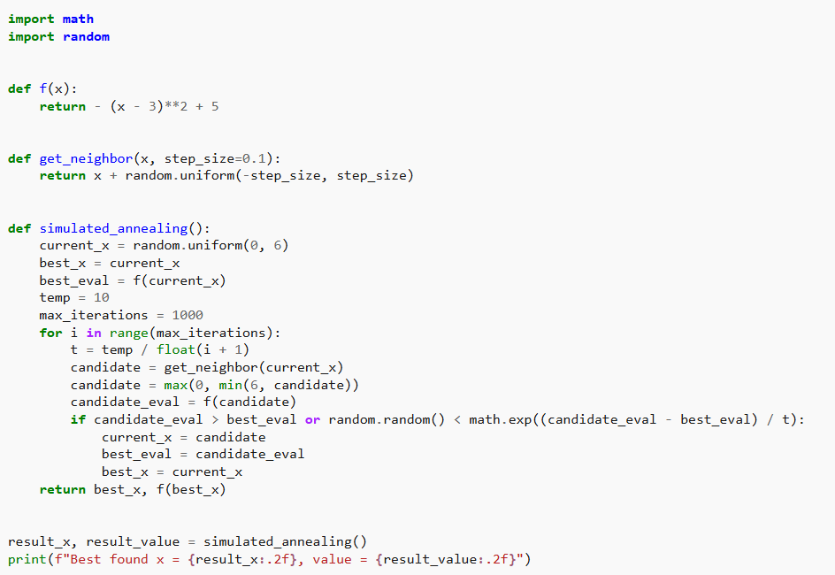
Simulated Annealing

Slide 8
3. Genetic Algorithms
Genetic Algorithms (GAs) are inspired by the process of natural selection and evolution. They work with a population of solutions and evolve them over time using genetic operators like selection, crossover and mutation.
Process:
Initialize: Start with a population of random solutions.
Evaluate: Assess the fitness of each solution.
Select: Choose the best solutions for reproduction based on their fitness.
Crossover: Combine pairs of solutions to produce new offspring.
Mutate: Apply random changes to offspring to maintain diversity.
Replace: Form a new population by selecting which solutions to keep.
Pros:
Can explore a broad solution space and find high-quality solutions.
Suitable for complex problems with large search spaces.
Cons:
Computationally expensive due to the need for evaluating many solutions.
Requires tuning of various parameters like population size and mutation rate.
Notes:
Genetic Algorithms(GAs) are adaptive heuristic search algorithms that belong to the larger part of evolutionary algorithms. Genetic algorithms are based on the ideas of natural selection and genetics. These are intelligent exploitation of random searches provided with historical data to direct the search into the region of better performance in solution space. They are commonly used to generate high-quality solutions for optimization problems and search problems.
Genetic algorithms simulate the process of natural selection which means those species that can adapt to changes in their environment can survive and reproduce and go to the next generation. In simple words, they simulate “survival of the fittest” among individuals of consecutive generations to solve a problem. Each generation consists of a population of individuals and each individual represents a point in search space and possible solution. Each individual is represented as a string of character/integer/float/bits. This string is analogous to the Chromosome.

Slide 9
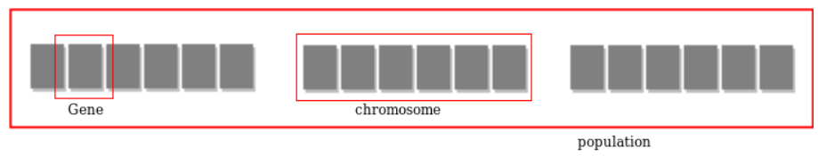
Genetic Algorithms
Foundation of Genetic Algorithms
Genetic algorithms are based on an analogy with the genetic structure and behavior of chromosomes of the population. Following is the foundation of GAs based on this analogy -
Individuals in the population compete for resources and mate
Those individuals who are successful (fittest) then mate to create more offspring than others
Genes from the “fittest” parent propagate throughout the generation, that is sometimes parents create offspring which is better than either parent.
Thus each successive generation is more suited for their environment.
Search space
The population of individuals are maintained within search space. Each individual represents a solution in search space for given problem. Each individual is coded as a finite length vector (analogous to chromosome) of components. These variable components are analogous to Genes. Thus a chromosome (individual) is composed of several genes (variable components).

Slide 10
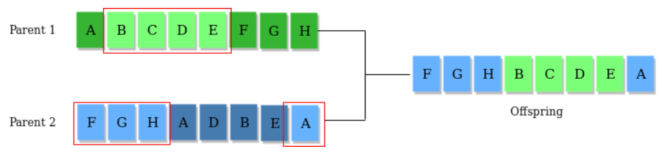
Genetic Algorithms
Fitness Score
A Fitness Score is given to each individual which shows the ability of an individual to “compete”. The individual having optimal fitness score (or near optimal) are sought.
Operators of Genetic Algorithms
Once the initial generation is created, the algorithm evolves the generation using following operators -
1) Selection Operator: The idea is to give preference to the individuals with good fitness scores and allow them to pass their genes to successive generations.
2) Crossover Operator: This represents mating between individuals. Two individuals are selected using selection operator and crossover sites are chosen randomly. Then the genes at these crossover sites are exchanged thus creating a completely new individual (offspring). For example -

Slide 11
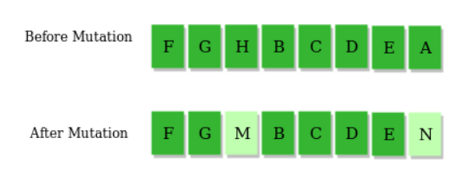
Genetic Algorithms
3) Mutation Operator: The key idea is to insert random genes in offspring to maintain the diversity in the population to avoid premature convergence. For example -

Slide 12
Genetic Algorithms
Example problem and solution using Genetic Algorithms
Given a target string, the goal is to produce target string starting from a random string of the same length. In the following implementation, following analogies are made -
Characters A-Z, a-z, 0-9, and other special symbols are considered as genes
A string generated by these characters is considered as chromosome/solution/Individual
Fitness score is the number of characters which differ from characters in target string at a particular index. So individual having lower fitness value is given more preference.
Link of Code : https://www.geeksforgeeks.org/dsa/genetic-algorithms/

Slide 13
Genetic Algorithms
As we can see from the output, our algorithm sometimes stuck at a local optimum solution, this can be further improved by updating fitness score calculation algorithm or by tweaking mutation and crossover operators.
Why use Genetic Algorithms
They are Robust
Provide optimisation over large space state.
Unlike traditional AI, they do not break on slight change in input or presence of noise
Application of Genetic Algorithms
Genetic algorithms have many applications, some of them are -
Recurrent Neural Network
Mutation testing
Code breaking
Filtering and signal processing
Learning fuzzy rule base etc

Slide 14
Ant Colony Optimization
Different optimization techniques have thus evolved based on such evolutionary algorithms and thereby opened up the domain of metaheuristics. Metaheuristic has been derived from two Greek words, namely, Meta meaning one level above and heuriskein meaning to find. Algorithms such as the Particle Swarm Optimization (PSO) and Ant Colony Optimization (ACO) are examples of swarm intelligence and metaheuristics. The goal of swarm intelligence is to design intelligent multi-agent systems by taking inspiration from the collective behaviour of social insects such as ants, termites, bees, wasps, and other animal societies such as flocks of birds or schools of fish.
Notes:
Inspiration: Ants finding shortest paths using pheromone trails.
Mechanism:
Virtual ants explore possible solutions.
Paths are reinforced with pheromones based on quality.
Evaporation prevents premature convergence.
Self-Modification:
Pheromone update and evaporation adaptively change search direction.
Applications: Network routing, TSP, logistics planning.

Slide 15
ANT ALGORITHM
Another Collective Intelligence Approach
Several collective behaviors have been observed in ants and other insect societies
These include foraging for food (most famous), nest building, division of labor, cooperative support, self assembly and cemetery organization

Slide 16
ANT ALGORITHM
Another Collective Intelligence Approach
For several decades researchers have been fascinated by the emergent behavior of colonies of social insects, such as ants & termites
Despite the relative simplicity of an individual's behavior, the colony as a whole can exhibit highly adaptive behavior, leading researchers to consider the adaptation of these collective processes for use in the area of artificial intelligence

Slide 17
ANT ALGORITHM
Food Foraging Behaviour
Observations of the foraging behavior of ants has inspired the development of ant-based algorithms
These algorithms are used to solve mainly combinatorial optimization problems defined over discrete search spaces
One of the first behaviors studied by ethologists was the ability of ants to find the shortest path between their nest and a food source. These studies resulted in the first algorithmic models of the foraging behavior of ants (Dorigo)
Notes:
Ethologists: Ethology is the scientific study of animal behavior, focusing on how and why animals behave the way they do — particularly in their natural environments.

Slide 18
ANT ALGORITHM
Food Foraging Behaviour
How do ants find the shortest path between their nest and food source, without any visible, central, active coordination mechanism?
Studies have shown that the search for food is random in the beginning
As soon as a food source is located activity becomes more organized with more and more ants following the same (shortest) path to the food source

Slide 19
ANT ALGORITHM
Food Foraging Behaviour
The recruitment mechanism is usually in the form of indirect communication
When an ant locates a food source, it carries a food item to the nest and lays pheromone along the trail Other ants decide which path to follow based on the pheromone concentrations on the different paths
Paths with a larger pheromone concentration have a higher probability of being selected

Slide 20
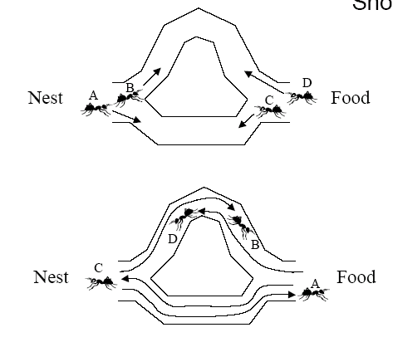
ANT ALGORITHM
Another Collective Intelligence Approach
For instance, ants have a remarkable ability to find the shortest path from the nest to a food source, mediated by pheromones, chemical substances secreted by one individual to modify the behavior of others

Slide 21
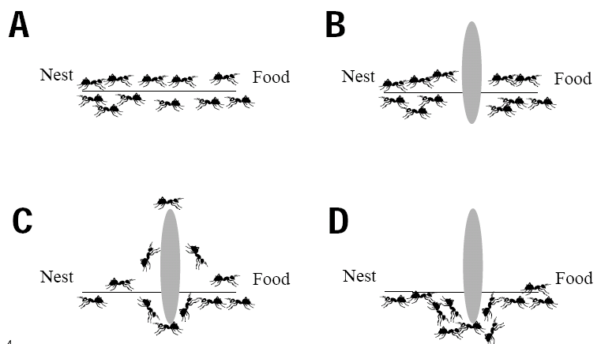
ANT ALGORITHM

Slide 22
ANT ALGORITHM
Another Collective Intelligence Approach
Ants are able to quickly find their way to and from food and the method by which they do it is modeled in a new approach called the ant algorithm
This algorithm was developed by Marco Dorigo and is still the subject of on going research
Ant algorithm is a population based approach & hence it falls in the same category as Genetic algorithms & Particle Swarm algorithm

Slide 23
ANT ALGORITHM
Ant Algorithm
An artificial ant can be considered as a simple computational agent, A logic is implemented in the artificial ant to select a path whenever there are several paths which can be followed
A number of artificial "ants" construct solutions to the problem at hand by the repeated selection of parts from a predefined set of solution components
These ants select components probabilistically biased by heuristic information (a problem specific heuristic measure of a component's utility) and pheromone information, typically associated with the solution components

Slide 24
ANT ALGORITHM
Ant Algorithm
To simulate the real-world process by which ants find the shortest path to a food source, electronic ants deposit pheromone on components in proportion to the quality of the solutions that contain them
This is similar to a shorter path receiving pheromone reinforcement sooner than a longer path (as ants return from the food source sooner), thereby increasing the likelihood that later ants will choose the shorter path over the longer one

Slide 25
ANT ALGORITHM
Ant Algorithm
ACO has been applied to solve many problems
Well suited to discrete optimization problems
  Job scheduling
  Subset problems
  Network routing
  Vehicle routing
  Bioinformatics
  Data mining
For the application of ACO to a problem we need
  A representation of solution
  A method to determine the fitness of the solution
  A heuristic measure for the solution’s component

Slide 26
ANT ALGORITHM
Ant Algorithm and the TS problem
The algorithm stops when some stopping criterion is met, e.g. a certain number of generations has been done or the best found solution has not changed for several generations

Slide 27
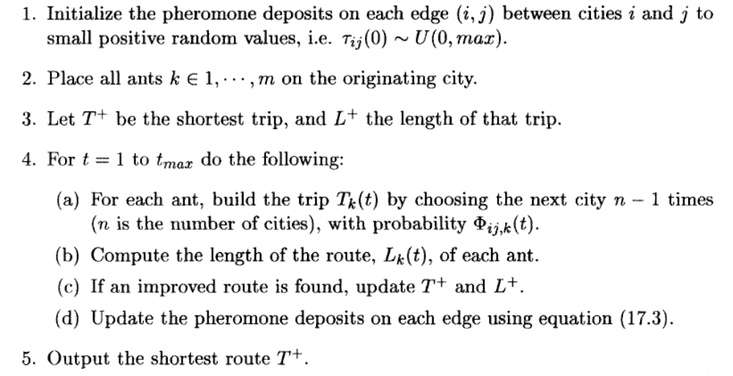
ANT ALGORITHM
Ant Algorithm

Slide 28
DIFFERENTIAL EVOLUTION
Introduction
Differential evolution (DE) is a population-based search strategy very similar to standard evolutionary algorithms
The main difference is in the reproduction step used by DE, which presents the advantage that DE can operate on flat surfaces
DE has been applied successfully to the design of digital filters, mechanical design optimization and evolving game strategies

Slide 29
Particle Swarm Optimization (PSO) - An Overview
The process of finding optimal values for the specific parameters of a given system to fulfill all design requirements while considering the lowest possible cost is referred to as an optimization. Optimization problems can be found in all fields of science.
Conventional optimization algorithms (Deterministic algorithms) have some limitations such as:
single-based solutions
converging to local optima
unknown search space issues
To overcome these limitations, many scholars and researchers have developed several metaheuristics to address complex/unsolved optimization problems. Example: Particle Swarm Optimization, Grey wolf optimization, Ant colony Optimization, Genetic Algorithms, Cuckoo search algorithm, etc.
The Introduction to Particle Swarm Optimization (PSO) article explained the basics of stochastic optimization algorithms and explained the intuition behind particle swarm optimization (PSO). This article aims to deep dive into particle swarm optimization (PSO).

Slide 30
PSO-Inspiration of the algorithm
Particle Swarm Optimization (PSO) is a powerful meta-heuristic optimization algorithm and inspired by swarm behavior observed in nature such as fish and bird schooling. PSO is a Simulation of a simplified social system. The original intent of PSO algorithm was to graphically simulate the graceful but unpredictable choreography of a bird flock.
In nature, any of the bird’s observable vicinity is limited to some range. However, having more than one birds allows all the birds in a swarm to be aware of the larger surface of a fitness function.
Let’s mathematically model, the above-mentioned principles to make the swarm find the global minima of a fitness function

Slide 31
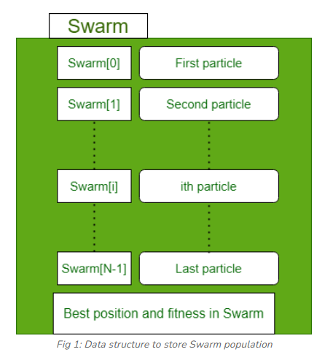
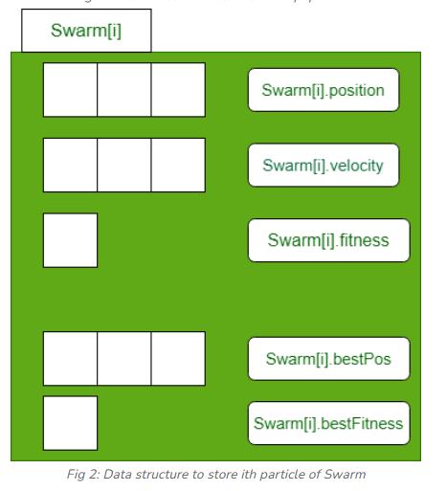
PSO-Mathematical model
Each particle in particle swarm optimization has an associated position, velocity, fitness value.
Each particle keeps track of the particle_bestFitness_value particle_bestFitness_position.
A record of global_bestFitness_position and global_bestFitness_value is maintained.

Slide 32
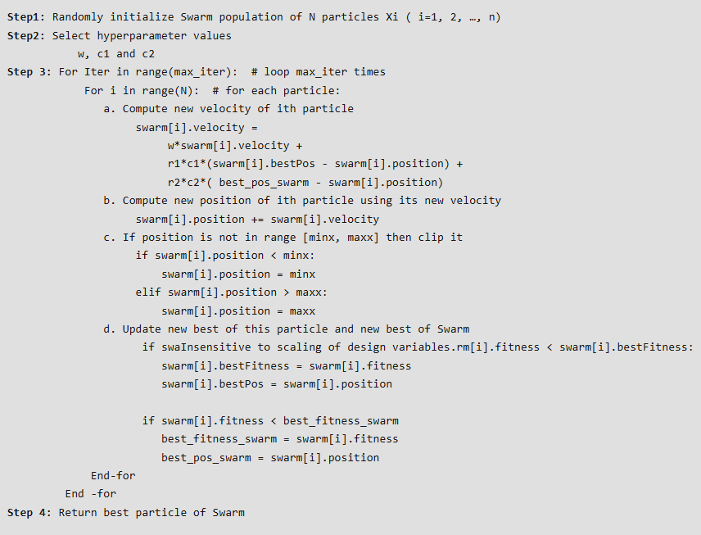
PSO-Algorithm

Slide 33
DIFFERENTIAL EVOLUTION
Introduction
Differential evolution has a new arithmetic operator which depends on the differences between randomly selected pairs of individuals
Differential Evolution operates better on fitness surfaces which are flat

Slide 34

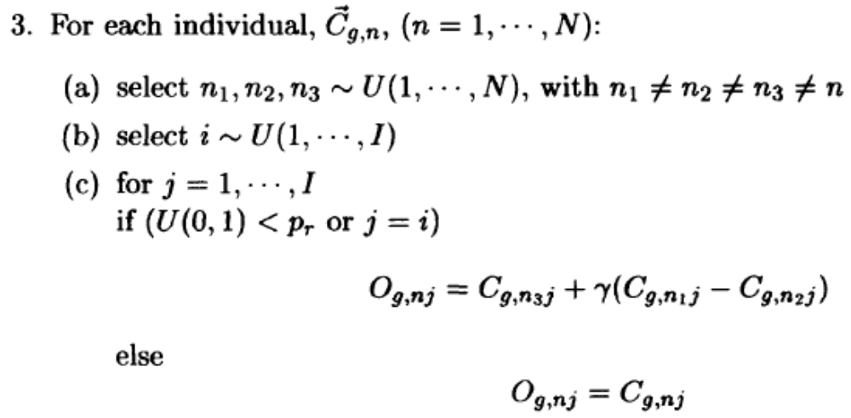
DIFFERENTIAL EVOLUTION
Differential Evolution Algorithm
g is initialized to 0, indicating the first generation.
p_r and γ are crossover prob and scalling factor for
mutation
Iterate over individuals
Select random indices:
Select a random index for mutation
Apply mutation and crossover

Slide 35
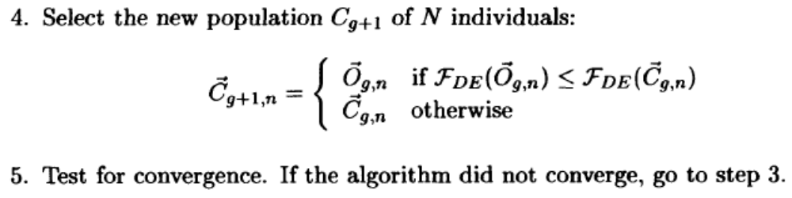
DIFFERENTIAL EVOLUTION
Differential Evolution Algorithm

Slide 36
DIFFERENTIAL EVOLUTION
Opposition Based Differential Evolution
Evolutionary optimization methods start with some initial solutions (initial population) and try to improve them toward some optimal solution
The computation time is related to the distance of these
initial guesses from the optimal solution
We can improve our chance of starting with a closer
(fitter) solution by simultaneously checking the opposite
solution

Slide 37

DIFFERENTIAL EVOLUTION
Opposition Based Differential Evolution
Opposite Number:
Let x є [a,b] be a real number. The opposite number is
defined by
Opposite Point:
Let P = (x1,x2,…,xD) be a point in D-dimensional
space, where x1,x2,…,xD є R and xi є [ai,bi] i є {1,2,…,D}. The opposite point is completely defined by its components

Slide 38
DIFFERENTIAL EVOLUTION
Opposition Based Differential Evolution
Assume a point in D-dimensional space (i.e., a candidate solution) and its opposite point. If fitness of opposite point is greater than the point, then the point can be replaced by the opposite point otherwise we continue with the original point
Hence point with its opposite point are evaluated simultaneously in order to continue with the fitter one
The same approach can be applied not only to initial solutions but also continuously to each solution in the current population

Slide 39
CO-EVOLUTION

Slide 40
CO-EVOLUTION
Introduction
Co-evolution is the complementary evolution of closely associated species
In the next generation, each species changes in response to the actions of the other species during the previous generation
The co-evolution between two species is nicely illustrated using Holland's example of the competitive interaction between a plant and insects

Slide 41
CO-EVOLUTION
Introduction
The effect of this co-evolutionary process is that, with each generation, both the plant and the insects become better at their defensive and offensive roles
In the next generation, each species change in response to the actions of the other species during the previous generation

Slide 42
CO-EVOLUTION
Introduction
There are two types of co-evolution:
- Predator prey or Competitive co-evolution
- Symbiotic or Cooperative co-evolution

Slide 43
CO-EVOLUTION
Introduction
The biological example described above is an example of predator-prey co-evolution,
Where there is an inverse fitness interaction between the two species, A win for the one species means a failure for the other
To survive, the "losing" species adapt to counter the "winning" species in order to become the new winner

Slide 44
CO-EVOLUTION
Competitive Co-evolution
Usually applied to two agent games, where the objective is to evolve a game strategy to defeat the opponent
Major difference:
No pre-defined fitness function
Usually two competing populations are created and the quality of an individual is evaluated by its peers in another population

Slide 45
CO-EVOLUTION
Competitive Co-evolution
Standard EAs use a user-defined fitness function that reflects optimality
The fitness of each individual is evaluated independently from any other population using this fitness function
In CoE, the driving force of the evolutionary process is through a relative fitness function, the performance of individuals in one population in comparison with individuals in another population
The only quantification of optimality is which population's individuals perform better

Slide 46

CO-EVOLUTION
Competitive Co-evolution
Relative Fitness Evaluation
The following approaches can be followed to measure the relative fitness of each individual in a population
Assume that the two populations A and B co-evolve and
the aim is to calculate the relative fitness of each individual CA,nof population A

Slide 47
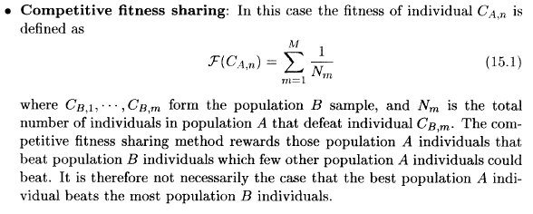
CO-EVOLUTION
Competitive Co-evolution
Relative Fitness Evaluation

Slide 48
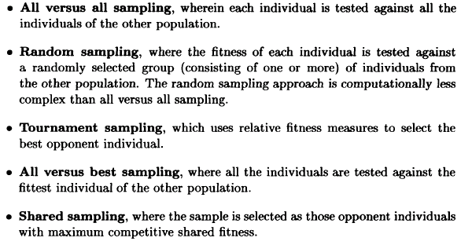
CO-EVOLUTION
Competitive Co-evolution
Fitness Sampling

Slide 49
CO-EVOLUTION
Competitive Co-evolution
Hall of Fame
It is like elitism
The best individual of each generation is retained, since evolution started
The opponent population has a much more difficult task to adapt to these best individuals
Notes:
Elitism in evolutionary algorithms is a strategy where the best-performing individuals from one generation are copied directly into the next generation, ensuring they are not lost to crossover or mutation.

Slide 50
CO-EVOLUTION
Cooperative Co-evolution
An alternative co-evolutionary process is symbiosis, in which case the different species cooperate instead of competing
In this case a success in one species improves the survival strength of the other species
Symbiotic co-evolution is thus achieved through a positive fitness feedback among the species that take part in this cooperating process

Slide 51
CO-EVOLUTION
Cooperative Co-evolution
The problem is divided into different parts and a sub-population is created to solve one part of the problem
For example, a sub-population may get the task of evolving (& optimizing) only one gene
Hence there will be as many sub-populations as the number of genes
Normal fitness function is used

Slide 52
CO-EVOLUTION
Cooperative Co-evolution
But since an individual in a sub-population is only one gene of the total chromosome
Hence all the sub-populations have to give one gene-value to make up a complete chromosome
To evaluate the individuals of a sub-population, a complete chromosome is constructed using best gene values from other sub-populations
This chromosome is called ‘context vector’

Slide 53
CO-EVOLUTION
Cooperative Co-evolution
The main problem is how to determine the best individual
of a subpopulation, since individuals do not represent complete solutions
A simple solution to this problem is to keep all other components (genes) within a complete chromosome fixed and to change just the gene that corresponds to the current subpopulation for which the best individual is sought
For each individual in the subpopulation, the value of the corresponding gene in the complete chromosome is replaced with that of the individual. Values of the other genes usually kept fixed at the previously determined best values

Slide 54
Comparative Summary Table
Algorithm (Full Form) | Inspiration | Self-Modification | Strength | Typical Use
GA – Genetic Algorithm | Darwinian evolution | Mutation & crossover rates | Simple, robust | Discrete optimization problems
PSO – Particle Swarm Optimization | Swarm (bird/fish) behavior | Inertia weight & velocity updates | Fast convergence | Continuous optimization problems
ACO – Ant Colony Optimization | Ant foraging behavior | Pheromone update & evaporation | Excellent for routing and graph problems | Path optimization (TSP, routing)
DE – Differential Evolution | Vector-based evolution | Scaling factor & crossover rate | Efficient for real-valued search | Control parameter tuning, continuous optimization
CE – Cultural Evolution Algorithm | Human cultural learning | Belief space update | Knowledge reuse, social adaptation | Multi-objective & hybrid optimization
Co-Evolution Algorithm | Ecosystem interactions (predator–prey, symbiosis) | Mutual adaptation between populations | Promotes diversity & robustness | Game strategies, adversarial learning (e.g., GANs)
ES – Evolution Strategies | Biological mutation & self-adaptation | Adaptive mutation step size (σ) | High precision & self-tuning ability | Continuous domains, robotics, engineering design

Slide 55
DIFFERENTIAL, CULTURAL & CO-EVOLUTION
It has been shown that such a cooperative approach substantially improves the accuracy of solutions, and the convergence speed compared to non-cooperative, noncoevolutionary GAs.
References
Engelbrecht Chapter 13, 14 & 15

